Slide 1

Environment Club, THDC-IHET

Slide 2
EVENTS AND THEIR DURATION-

Slide 3
Environment Club, THDC-IHET Activities under Environment Club In the
Odd Semester, 2023-24
comprehensive campaign on 20 September
During the session, the Environment Club at THDC IHET organized a series of impactful initiatives aimed at promoting environmental awareness and sustainability on campus.
1) Awareness Sessions: The club initiated its campaign with informative sessions led by fourth-year students. These sessions were conducted class to class, focusing on educating students about the harmful effects of single-use plastics and promoting responsible consumption.
2) Cleanliness Drive: A campus-wide cleanliness drive against single-use plastics took place, with enthusiastic participation from first-year students. The campus was divided into blocks, each with dedicated coordinators overseeing cleanup efforts, fostering a sense of responsibility for maintaining a plastic-free environment.
3) Collaboration with Udaan: Partnering with Udaan, the club worked on producing paper envelopes as alternatives to plastic bags. Shopkeepers were encouraged to use these envelopes, supporting local students and promoting eco-friendly practices.
4) "Meri Mati Mera Desh" Campaign: [Details missing]
5) One Student One Tree Program: Each newly planted tree was tagged with a student's name, fostering a personal connection with nature and promoting ownership and responsibility for the environment.
6) Swachhta Hi Sewa Campaign: Another campus-wide cleanliness drive was organized, with enthusiastic participation from students across all years, further reinforcing the importance of maintaining a clean and healthy environment.
Overall, these initiatives reflect the club's commitment to creating a sustainable campus community and inspiring positive environmental change among students and beyond.

Slide 4
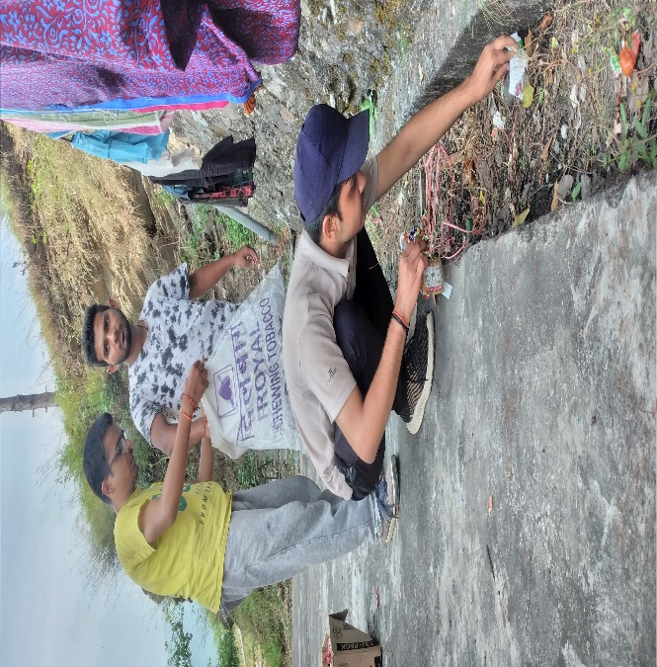
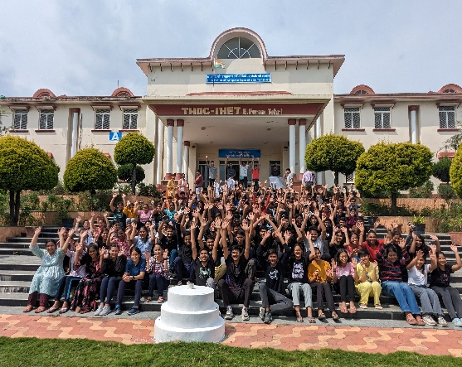
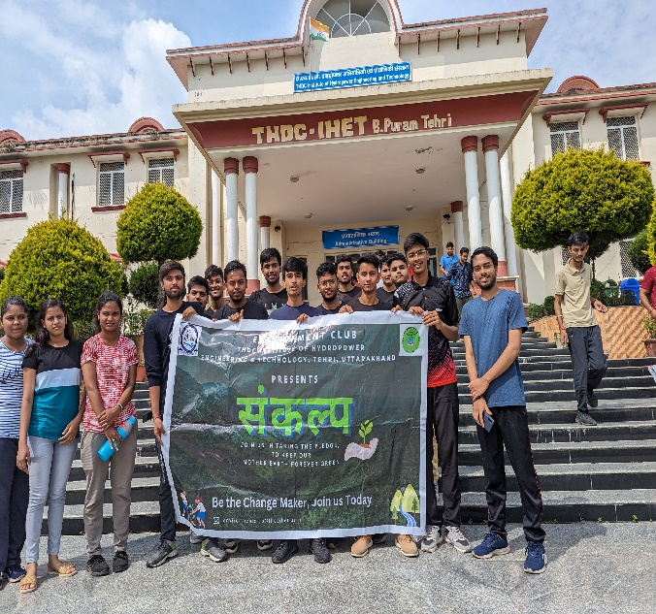
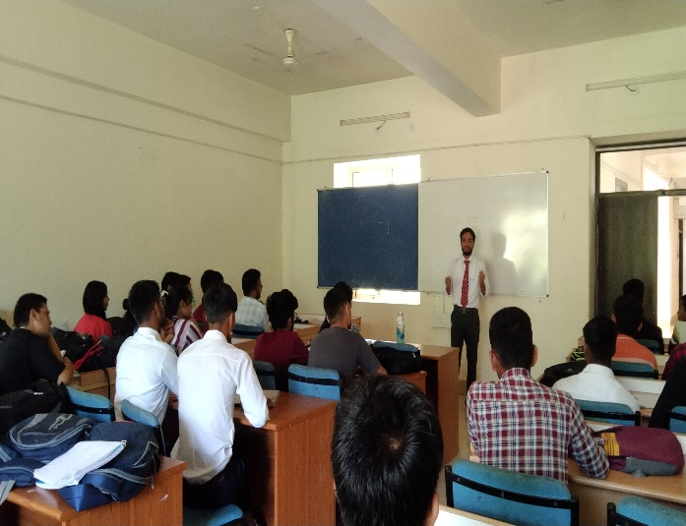
PHOTOS OF THIS EVENT -

Slide 5
Environment Club, THDC-IHET Activities under Environment Club In the
EVEN Semester, 2023-24
Event Summary: Slogan and Banner Competition
Occasion: International Day of Forests
Date: March 21, 2024
Organizer: Environment Club, THDC-IHET
Event Type: Online Slogan and Banner Competition
Objective:
The Environment Club hosted an online Slogan and Banner Competition to commemorate the International Day of Forests and World Poetry Day. The primary goals were to raise awareness about forest conservation and encourage creative expression among students.
Event Highlights:
- Online Format: Conducted via Google Forms for maximum participation.
- Dual Celebration: Integrated environmental consciousness with creative expression.
- Participation: Despite academic commitments, students showed remarkable enthusiasm, submitting diverse entries reflecting various perspectives on forest conservation.
Competition Categories:
- Theme: Forest conservation and sustainable development.
- Slogan Competition: Crafting impactful slogans.
- Banner Competition: Designing visually compelling banners.
Adjudication Process:
Entries were evaluated by a panel of judges based on creativity, relevance, and effectiveness in communication.
Recognition and Awards:
Winners were announced in each category and awarded online certificates, incentivizing further engagement in environmental initiatives.
Conclusion:
The Slogan and Banner Competition showcased the power of creativity in advocating for environmental conservation. Students' commitment to safeguarding natural heritage and driving positive change was evident. Such initiatives inspire collective action towards a sustainable future, reinforcing the Environment Club's mission to nurture environmental consciousness.

Slide 6
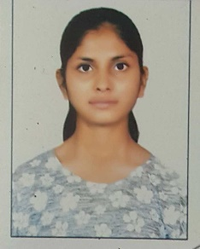
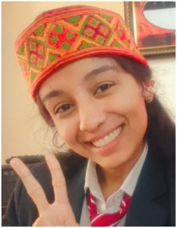
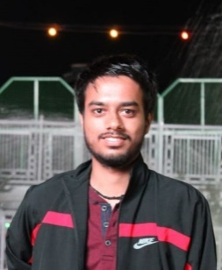
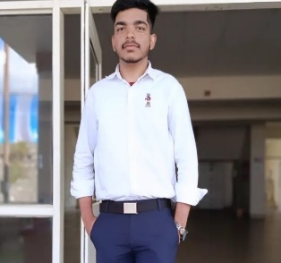

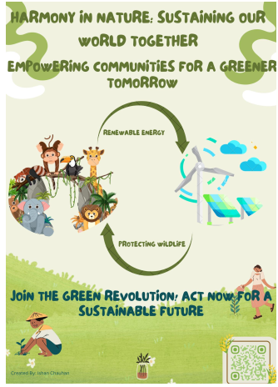
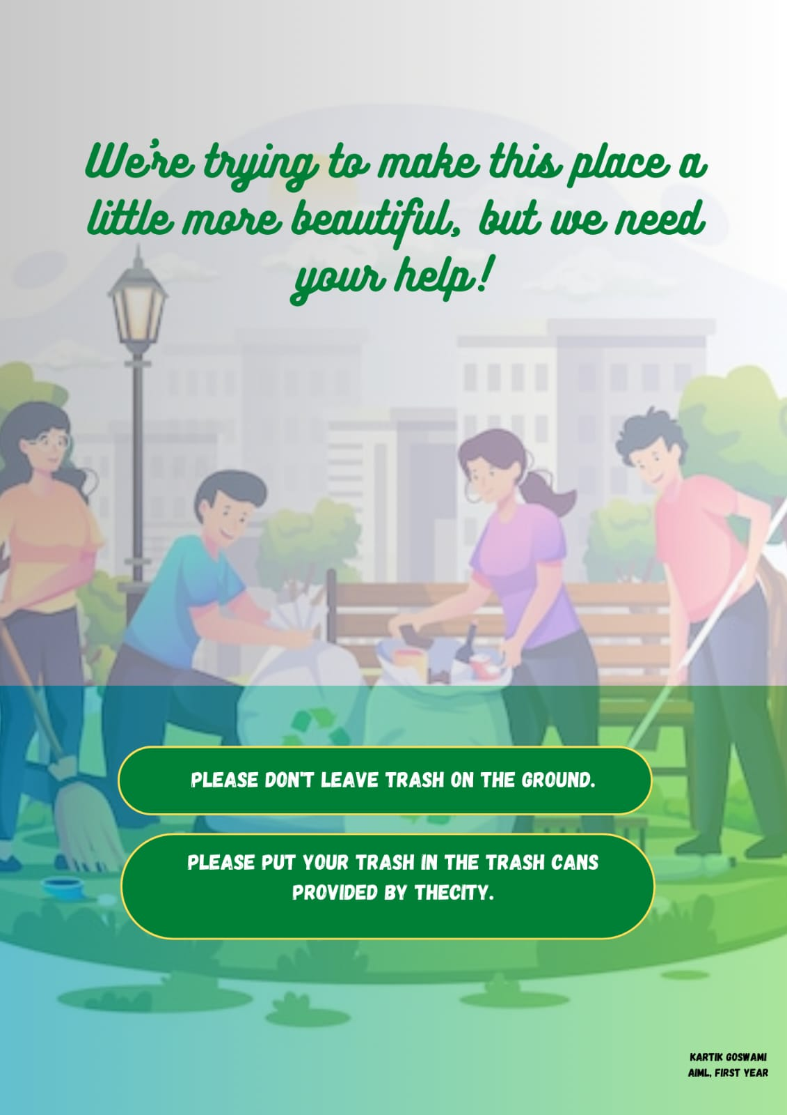
PHOTOS OF THIS EVENT -
WINNERS OF THIS EVENT AND THEIR BANNERS

Slide 7
CONCLUSION-
As we draw the curtains on the 2023-24 session, the Environment Club at THDC-IHET reflects on a year filled with impactful initiatives, meaningful collaborations, and inspiring achievements in the realm of environmental stewardship.
Throughout this session, our club has been at the forefront of promoting sustainability, raising awareness, and fostering a culture of eco-consciousness within our campus community. From organizing awareness sessions and cleanliness drives to hosting online competitions and collaborating with local organizations, we have consistently strived to make a positive difference in our environment.
We are proud of the dedication and enthusiasm shown by our members, whose tireless efforts have contributed to the success of each endeavor. Despite the challenges posed by academic schedules and external circumstances, our collective commitment to the cause has remained unwavering, underscoring the strength of our collective resolve.
As we bid farewell to this session, we carry with us the lessons learned, the memories cherished, and the bonds strengthened. We express our heartfelt gratitude to all members, volunteers, faculty advisors, and supporters who have been instrumental in our journey this year.
Looking ahead, we are filled with optimism and determination to continue our mission of environmental advocacy and action in the upcoming session. With renewed energy and fresh ideas, we remain committed to making an even greater impact and leaving a lasting legacy of sustainability for generations to come.
Thank you to everyone who has been a part of our journey this session. Together, let us continue to strive for a greener, cleaner, and more sustainable future.
Best wishes,
ENVIRONMENT CLUB THDC-IHET

